Slide 1
RELEASE AND ITERATIVE PLANNING
HARSH KUMAR
PANDHI RENUKA
NITIN KUMAR GAUR
ABHISEKH KUMAR YADAV
MANJUNATHA DURGESH

Slide 2

CONTENTS:
INTRODUCTION
RELEASE PLANNING
ITERATIVE PLANNING
REFERENCES

Slide 3
INTRODUCTION:
Iterative and incremental process paradigms are combined in the Agile Software Development Life Cycle (SDLC). By delivering a working software product quickly, it focuses on process adaptability and customer satisfaction. The product is broken down into small incremental builds using the Agile SDLC. Iterations of these builds are supplied.The workflow of the following are given below:
Concept:The idea is to imagine and prioritise projects.
Inception:The team is formed, financing is established, and the basic surroundings and requirements are negotiated.
Iteration:The software development team works to provide working software through iteration and constraint. It is based on customer input and requirements.
Release: Conduct quality assurance (QA) testing, give internal and external training, generate documentation, and integrate the final iteration into the product.
Production: This refers to the software's continuing maintenance.

Slide 4
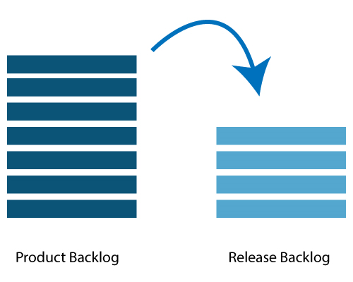
Release planning
Release planning allows you to schedule when and which product increments (versions) will be issued to the market. This method aids your team in adjusting to the unpredictability of software development. It's also an important aspect of the Agile SDLC (Software Development Life Cycle).
It is done in the interval of every 2 to 3 months.
FIG 1:RELEASE PLANNING

Slide 5
Who is engaged in the plan's release?
Scrum Master, Product Owner, Agile Development Team, and Stakeholders are all involved in the product release strategy.
Scrum Master: A Scrum Master is a team leader and facilitator who assists team members in adhering to agile practises in order to satisfy their obligations and customers' expectations.
Product Owner: From a commercial standpoint, the Product Owner is the person in charge of the product. He specifies the prerequisites and ranks them in order of importance.
Agile Development Team: The agile development team makes technical decisions and determines any dependencies.
Stakeholders: Stakeholders include customers, subject matter experts, and programme managers who serve as advisors on release planning decisions.

Slide 6
Planning Prerequisites:
The following are the prerequisites for release planning:The ranked product backlog is managed by a Product Owner.
The Product Owner believes that five to ten features should be included in the product when it is released.
Vision at a high level.
Market and business goals.
Input from the team based on capabilities, known velocity, or any technical obstacle.
It is necessary to be aware of the new product backlog items.

Slide 7
Data for Planning:
The following is a list of data that will be required during release planning:
Data from previous iterations or requests for release preparation.
Previous release/iteration action plans.
Consider the following features or flaws.
Calendars for work and personal use.
Estimated velocities based on past releases.

Slide 8
Agenda for Planning:
Welcome message, discussion of purpose, organising tools, and introduction to business sponsors at the opening event.
Vision and Roadmap for the Product:It provides a general overview of the product.
Look over the past releases:Any item that could have an impact on the product planning agenda was discussed.
Theme/name of the product release:It examines the current state of roadmap themes and, if necessary, makes adjustments.
Issues and concerns: We check any concern or issue on the agenda and then record it.
Review and Update the Definition of Done: Evaluate the product build or definition of done and make necessary modifications depending on technological advancements.
In retrospect, if you want the meeting to be successful, you should ask for input from the attendees.
Finally, congratulate on success.

Slide 9
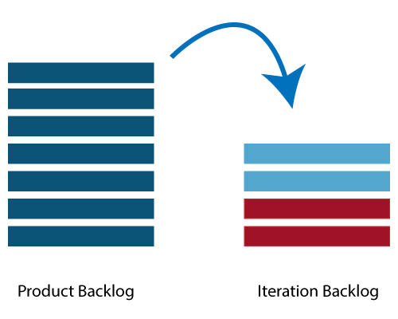
ITERATIVE PLANNING:
Iteration planning is mostly for the benefit of the team.A complete set of the top-ranked product backlog items should be represented on the team.Completing the top-ranked product backlog requires a commitment of time based on iteration length and team velocity.Iteration planning is used to coordinate work and define a reasonable scope for each iteration. Each Agile Team agrees on a set of stories (the iteration backlog) for the next iteration and summarises those stories into a set of iteration goals.
FIG 2:ITERATIVE PLANNING

Slide 10
One involved in iterative planning is same as the one involved in release plan i,e Scrum Master, Product Owner, Agile Development Team, Stakeholders.
Planning Prequisites:
The items in the product backlog have a size and a storey point attached to them.
The portfolio items were ranked by the product owner.
Each portfolio item's acceptance requirements are explicitly defined.
Process of Planning:
The following steps were included in iteration planning:
Determines the number of needs (stories) that can be accommodated in a single iteration.
Make a task list for this need.
Assign each work to its appropriate owner.
Each task is given a time estimate.These estimations aid team members in determining how many hours each member will need to iterate.
Tasks are distributed to team members based on their velocity or capability. As a result, the team member is not overworked.

Slide 11
VELOCITY CALCULATION:
The velocity is calculated by the agile team based on past iterations. A velocity is the average number of units that have to be completed in an iteration. Assume a team took 10,12,8 narrative points in each iteration for the past three iterations; this indicates that the team can pick 10 as the next iteration's velocity.The team's planned velocity shows them how many user needs they can finish in the current iteration. If the team completes the work allocated quickly, new user needs might be added. If not, the requirement can be pushed to the next iteration as well.
TASK CAPACITY:
The team's capacity is determined by three factors:The number of optimum working hours in a day is the total number of hours in a day.In each cycle, a person gives the total number of days.The percentage of time a team member is completely available.A team is defined as a group of six people who have agreed to work on a project full time for eight hours each day. If no one is on vacation during the iteration, the work capacity for a two-week iteration is 6 × 8 x 10 = 480 hours.

Slide 12
Steps in Iteration Planning:
The top ranked item on the product backlog is described by the Product Owner.
A member of the team specifies the tasks that must be completed in order to accomplish the item.
The tasks are owned by the members of the team.
Each team member estimates how long it will take them to complete each assignment.
The processes outlined above are repeated for each item in the iteration.
If a team member is overworked, his or her responsibilities are divided among the other team members.

Slide 13
References:
https://www.javatpoint.com/agile-release-planning
https://www.javatpoint.com/agile-iteration-planning
https://www.scaledagileframework.com/iteration-planning/

Slide 14




Thank you

